Slide 1

PROJECT (DATA ANALYSIS FOR K PIZZA)
Aim - The project can contribute to the successful implementation of online delivery services for K Pizza in Bangalore, ultimately leading to increased revenue through a more efficient and customer-friendly digital platform.
Introduction(About K Pizza)
Analysis Factors
Procedures
Stage – 1(Data Collection)
Stage – 2(Data Transformation And Loading To The Database)
Stage – 3(Performing Queries on the Loaded Data)
Data Visualization
Conclusion
By
Rohit Kumar

Slide 2
About K Pizza
K Pizza is a startup with 4 branches in Bangalore located in BTM Layout, J.P Nagar, Kormangala, Maratthahalli.
Data Collected for year 2018, 2019 and 2020.
Data Analysis is to be done on historical data, compare the revenue of each year data.
Find out how we can use the data to generate more revenue branch wise.
What discounts, or business strategies can be changed or added for more profit generating business in each branch.
K Pizza can position itself to successfully introduce home delivery services in Bangalore soon, attracting new customers and increasing revenue through the convenience of delivering pizzas directly to customer’s homes.

Slide 3
Data Analysis Factors
Analyze the business based on yearly, monthly, weekly revenue.
Analyze the data branch wise, type of pizza generating more sales.
Analyze the data branch wise based on the type of transaction cash or online.
Analyze what product generating more sales in each branch weekly.
Analyze branch wise what time of the day generating more sales.
Analyze what product is generating lowest sales and need to consider for offering discounts.

Slide 4
Procedures : (K Pizza Data Analysis Project)
Connect with the K Pizza team members to understand the business.
Data Collection from Sales Team.
Data Downloading for 4 Branches (In Single Excel File).
Data Cleaning Using Excel.
Data Processing And Transformation Using Excel.
Data Loading In Database SQL Server.
Performing SQL Query on the loaded data.
Exporting data from SQL Server to Excel.
Data Visualization in Excel, Finding insights through building dashboard using Excel.
Sharing Analysis result and suggestions based on findings with Stakeholder/Directors/Managers.

Slide 5
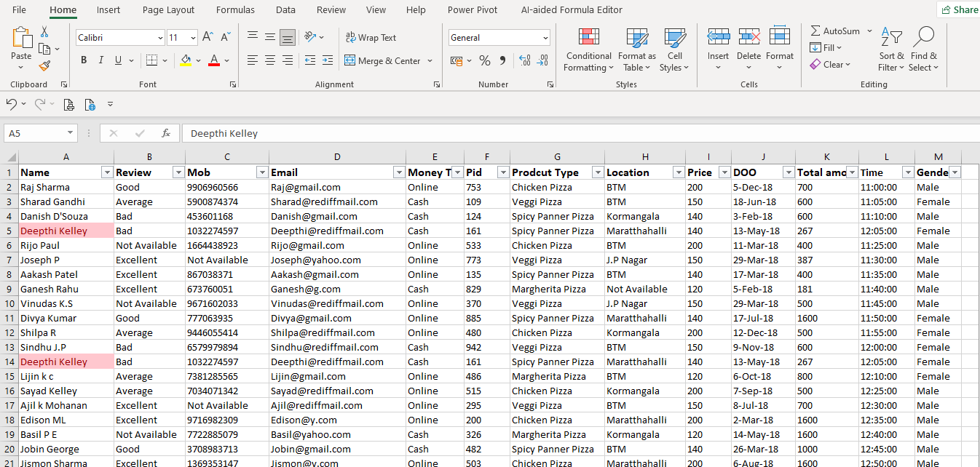
Data Cleaning
1. Remove the duplicates
Data > Remove duplicates > Select the columns Name, Mob > Select ok
Duplicates data will be deleted and the unique data will be remains same.
Remove Duplicates Data

Slide 6
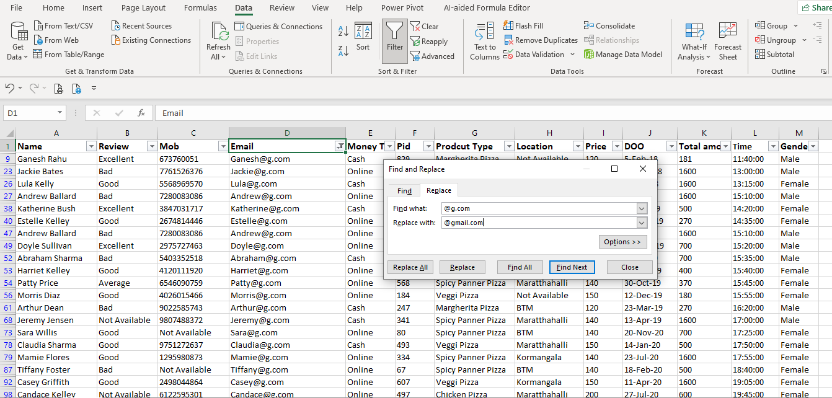
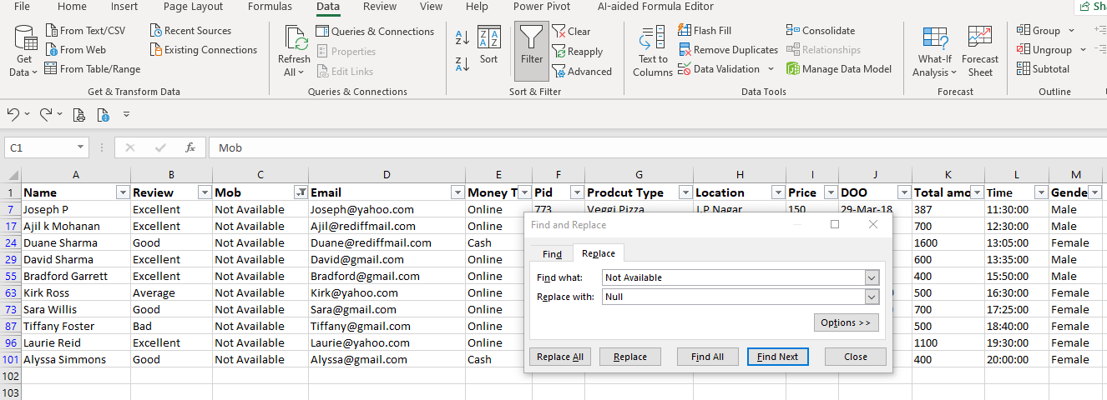
Data Cleaning
Find and Replace Email address
1. Find and replace email addresses so that data will be in standard format.
2. Replace Not Available cells by “Null” in multiple columns like Review, Mob and Location.
Replace Not Available with Null

Slide 7
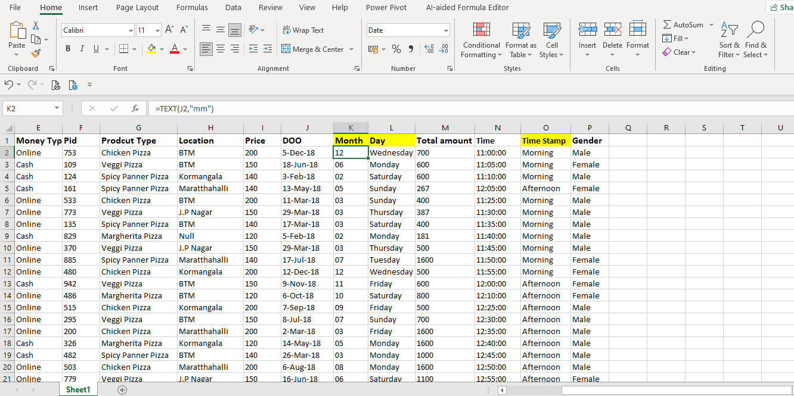
Data Processing
Processing the data based on the requirements for making report highlighted in yellow color.
1. Split the DOO(Date of order) into two columns day and month for better visualization.
2. Find shifts (Morning, Afternoon and Evening) from time data in excel to understand the business shift wise.
Find 3 shifts (Morning, Afternoon and Evening) from time data in excel
Split DOO into two columns month and day

Slide 8
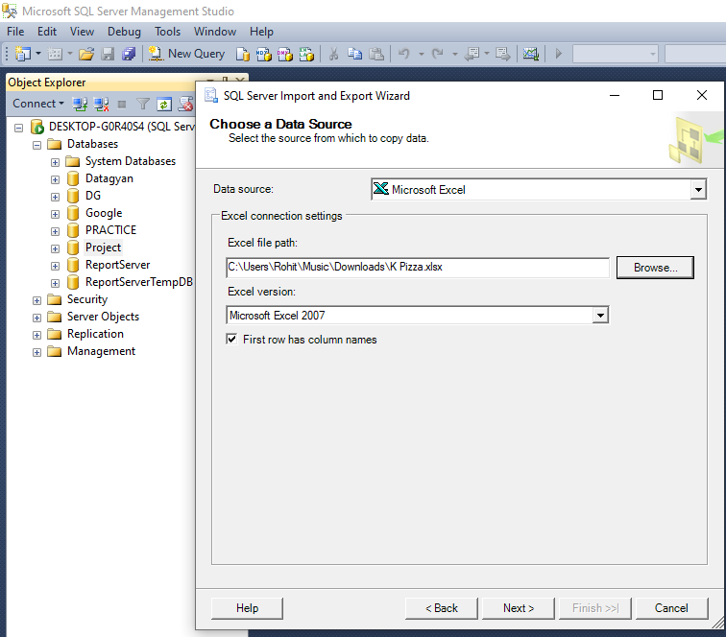
Import Data To SQL Server
Save Cleaned excel file as K Pizza.xlsx
Steps Followed to import Excel File in SQL Server
Open SQL Server and select database and right click >> task >> Import Data >> Select Microsoft Excel in data source >> Excel File Path >> Click Next
Select database>>Right click>>Tasks>>Import Data>>Select Microsoft Excel in data source>>Choose file path>>Click Next

Slide 9
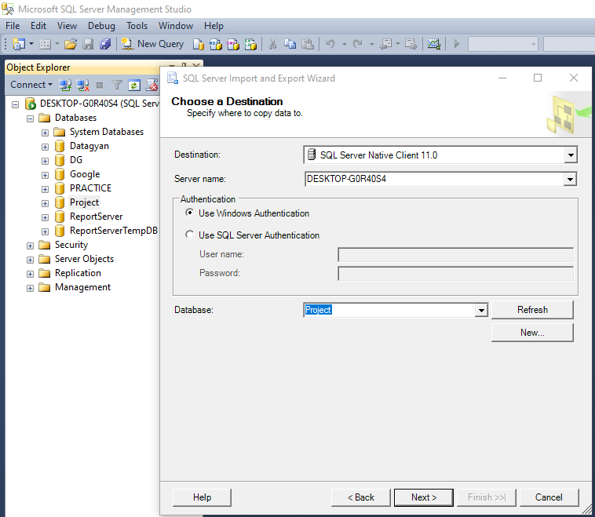
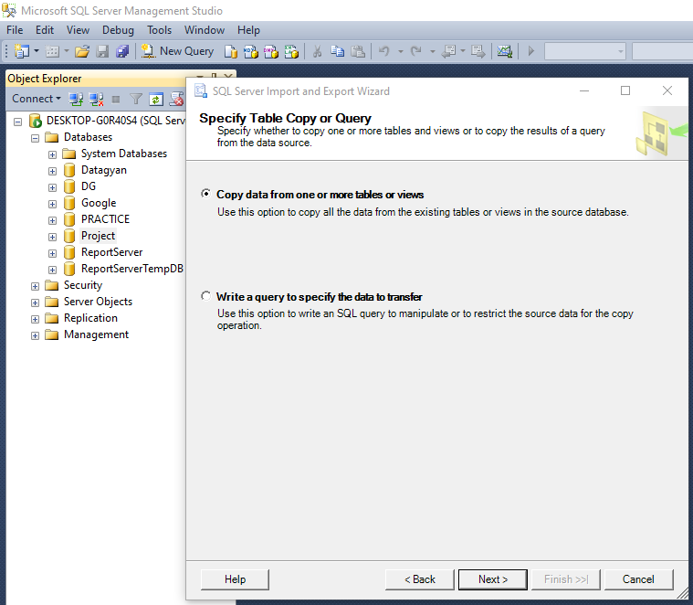
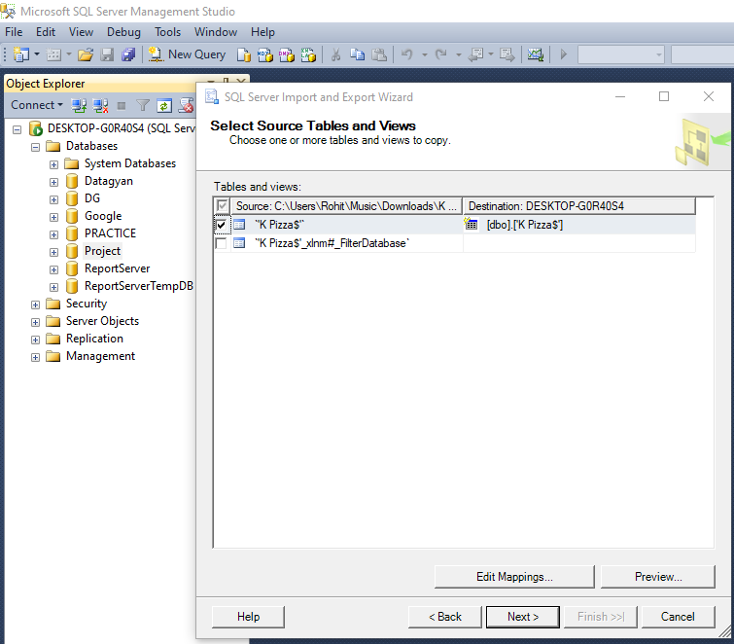
Import Data To SQL Server
Click on Next >> Click Next>> Then select the source table we can do modifications in data type in Edit Mappings and using preview option we can preview the dataset.
2nd Step -- Choose the destination as SQL Server>>Click Next
4th Step – We can change the data type in Edit Mappings and Preview the data also
3rd Step – Click Next

Slide 10
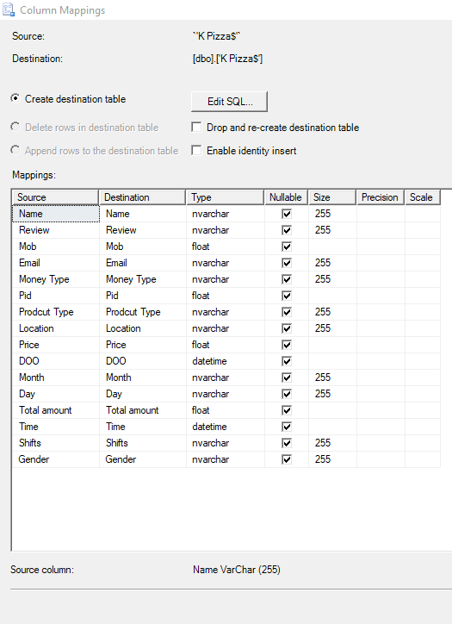
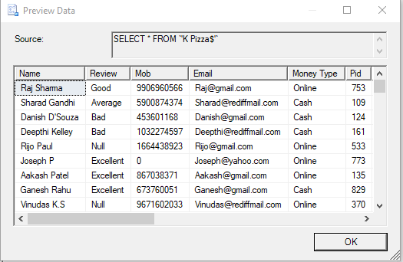
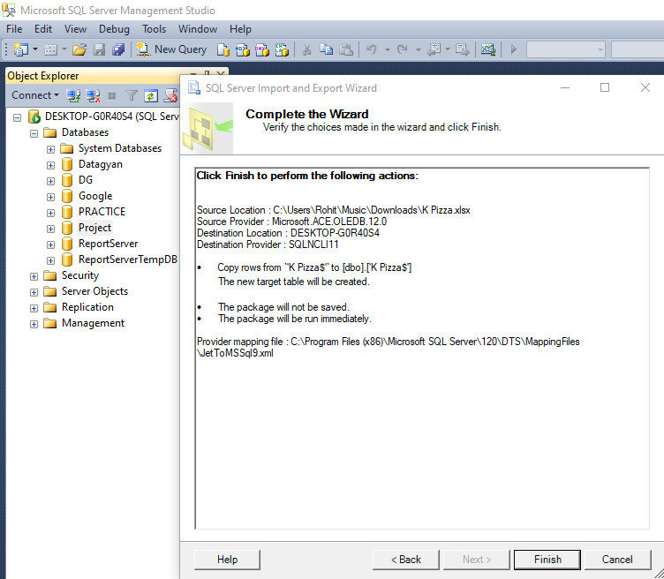
Import Data to SQL Server
We can follow the steps to load the data to the server successfully so we can perform Query through Analysis.
Column Mappings Page for Modifications
We Can Click on Finish>>Data will be loaded to Server
Preview Data Page

Slide 11
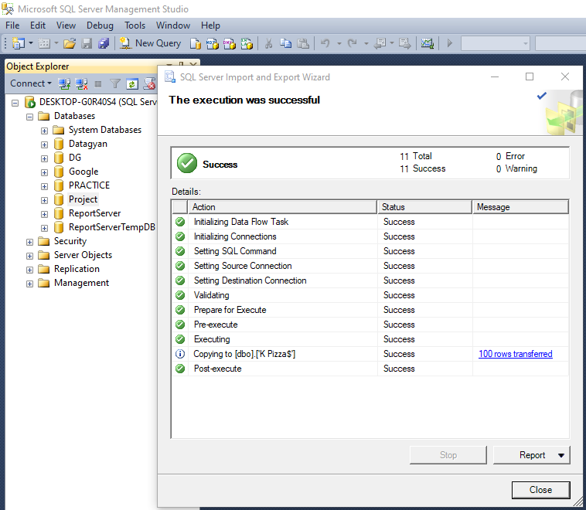
Import Data to SQL Server
Data loading to the SQL Server is successful with no errors and warnings.
Select the database in which we have imported the data and perform the SQL queries.
After performing SQL queries extract the data in excel sheet for visualization.

Slide 12
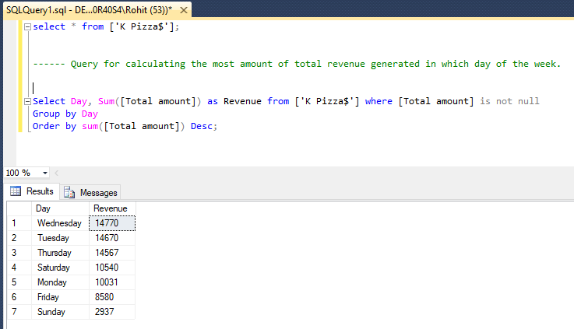
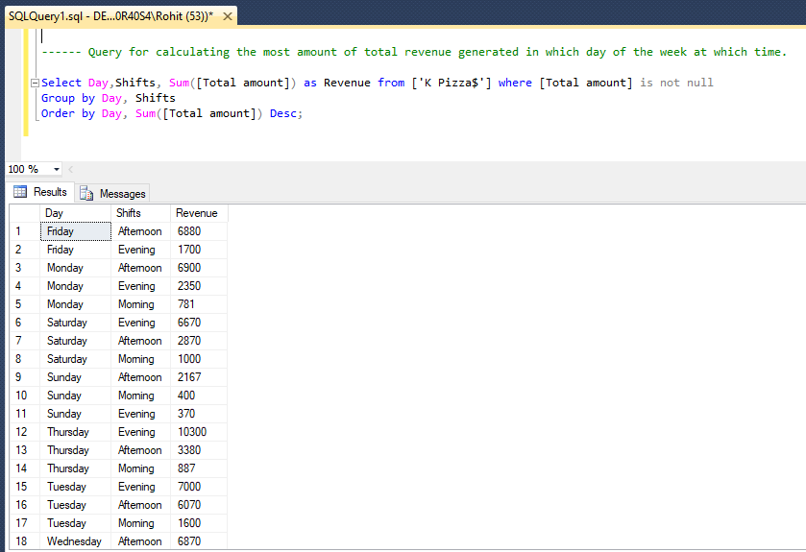
SQL Queries
1. Query for calculating the most amount of revenue generated in which day of the week.
2. Query for calculating the most amount of revenue generated in which day of the week at which shifts.

Slide 13
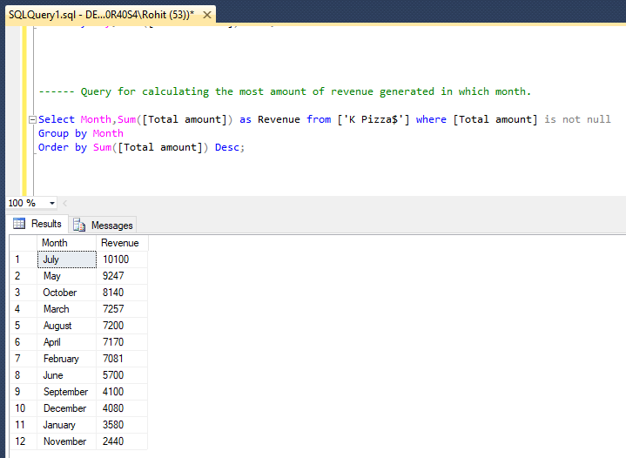
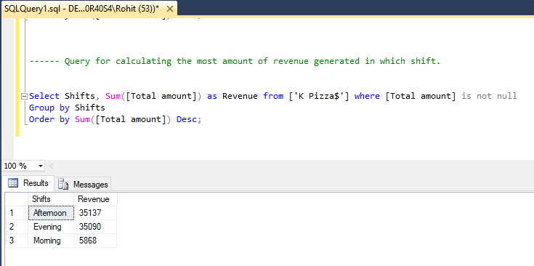
SQL Queries
3. Query for calculating the most amount of revenue generated in which shifts.
4. Query for calculating the most amount of revenue generated in which month.

Slide 14
Data Visualization
Create graphical view of shift wise sales using pivot table and column chart in Excel.
Create graphical view of gender wise sales using pivot table and pie chart in Excel.

Slide 15
Data Visualization
Created graphical view of location wise sales using pivot table and column chart in Excel.
Created graphical view of Category wise sales using pivot table and clustered bar chart in Excel.

Slide 16
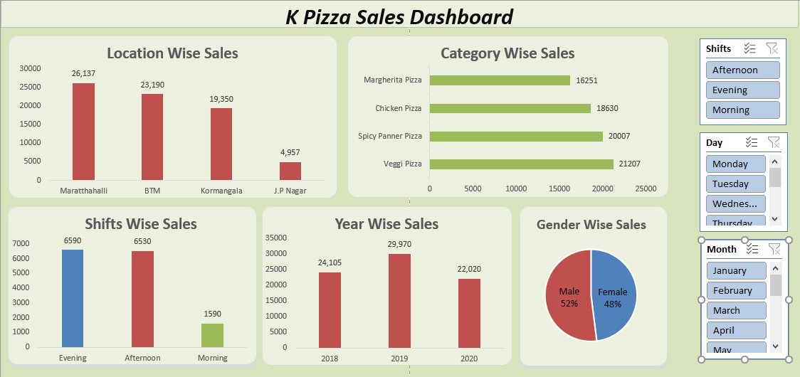
Dashboard/Report (360 View of Business)

Slide 17
Conclusion : K Pizza can go for home delivery as there is heavy demand in the multiple areas for the takeaway in evening and afternoon timings and have good sales in both the shifts. So we can try to give the best offers to the genuine customer.
Advantages :
May lead to increase in the revenue as we are moving business for home delivery so the user can get the pizza in the home itself they do not have to come to the store to order. Multiple things will be added for home delivery like reduce the staff for delivery(staff cutting), we have to add the delivery charges(cost cutting).

